Slide 1

Energy ressources, conversion and distribution Solar technology
Dr Sylvain Serra
Associate Professor
ENSGTI-LATEP
Office 314 (3th floor)
 +33 5 40 17 51 36
 sylvain.serra@univ-pau.fr
2019-2020

Slide 2
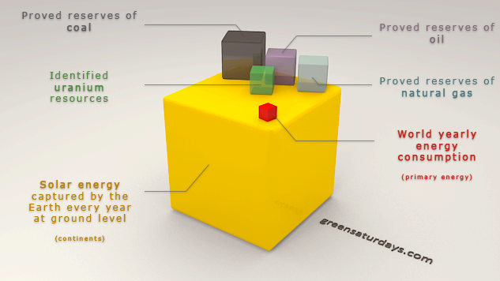
Introduction

Slide 3

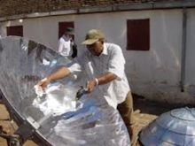
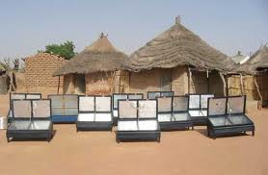

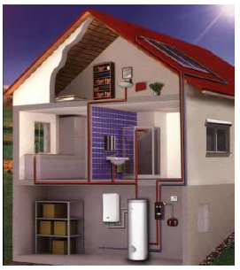
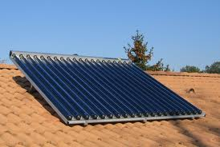
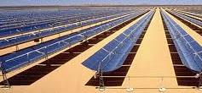
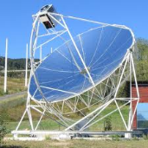
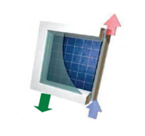
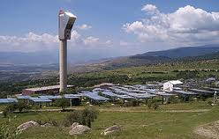
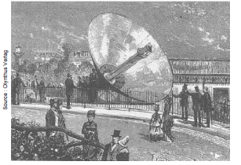
Introduction
Electricity
Thermal
PhotoVoltaic
PV
Solar cooker
Concentrating Solar Power (CSP)
Solar Heating and Cooling
SHC
PV-T

Slide 4
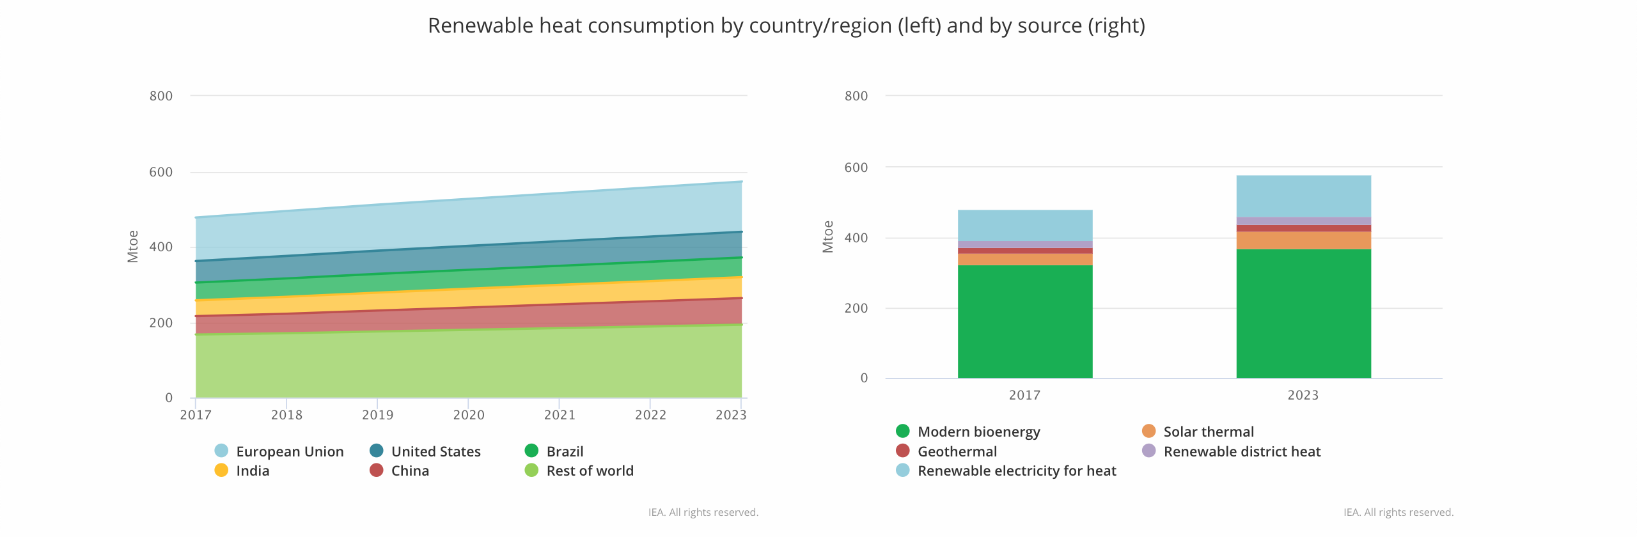
Solar thermal technologies
The market:
IEA : Renewables 2018

Slide 5
Solar thermal technologies
The market:
Space and water heating
Not Heat
Agriculture use
Industrial heat
Total energy consumption

Slide 6
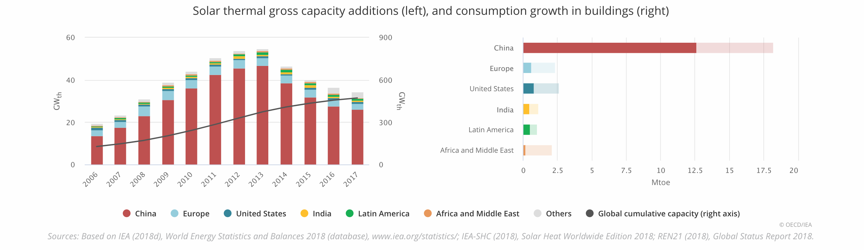
Solar thermal technologies
The market:
2017
2018-2023
IEA : Renewables 2018

Slide 7
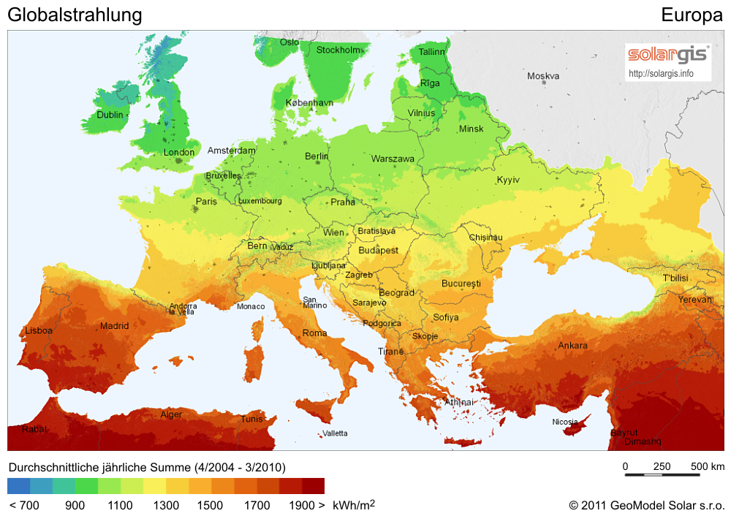
Solar thermal technologies
Market VS Irradiation:
Germany: 146 Wth/inh.
France : 24 Wth/inh.

Slide 8
Solar thermal technologies
2) Thermodynamic solar system
Conclusions and prospects

Slide 9
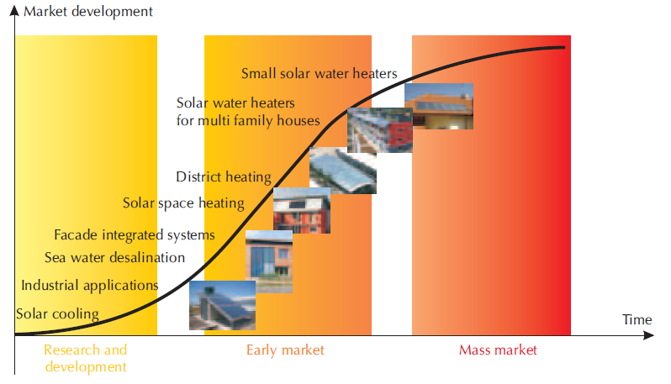
Solar thermal technologies
Source: Solar Energy Perspectives, IEA 2011

Slide 10

Solar thermal technologies
« Low temperature » solar collector
Uncovered solar collector
Flate plate solar collector
(DWH, building heating)
Evacuated tube solar collector
(… + solar chiller,
industrial application)
INCREASE : - T°C Level
- Efficiency
- Price

Slide 11
Solar thermal technologies
Source: Solar Energy Perspectives, IEA 2011

Slide 12
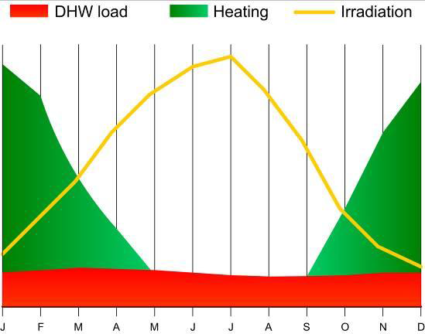
Solar thermal technologies
Active solar heating
Source: Papillon P., Plateforme technologie de l’AIE, 2012
http://www.iea.org/media/technologyplatform/workshops/solarenergyinmoroccooriental/PhilippePapillon.pdf

Slide 13
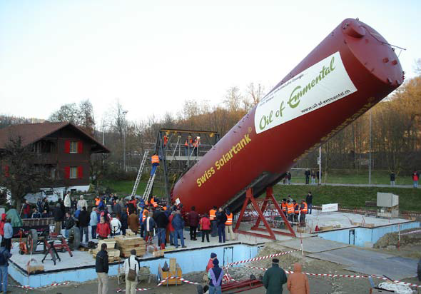
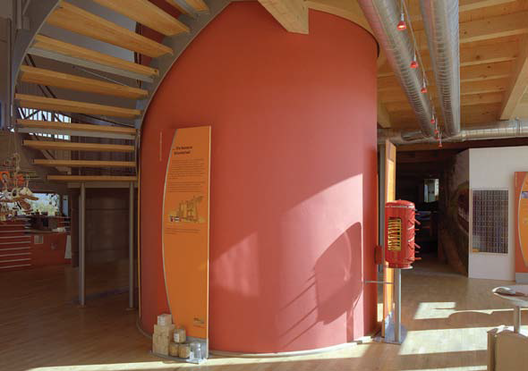
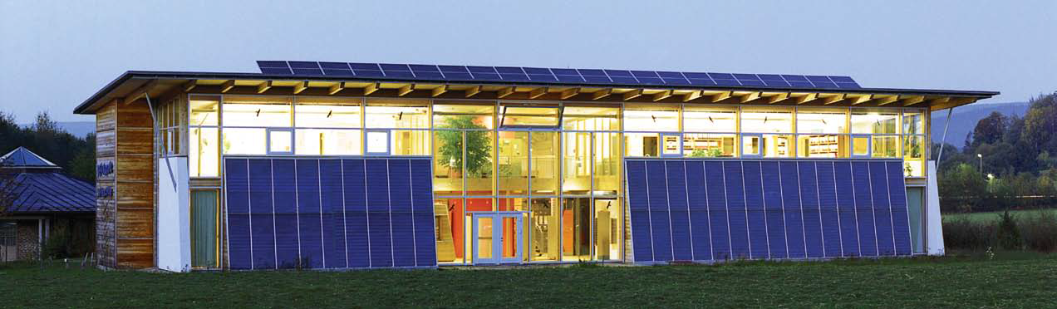
Solar thermal technologies
Active solar heating

Slide 14
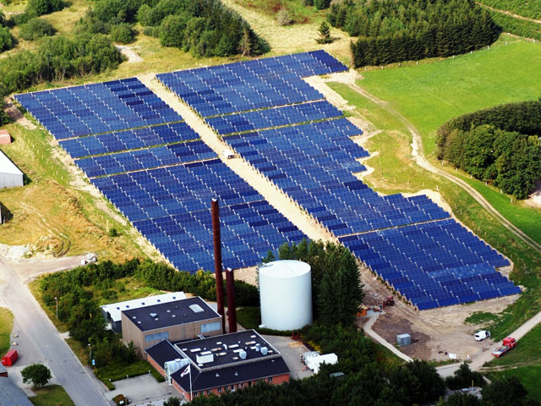
Solar thermal technologies
District heating network
Braedstrup (Danemark)
Built in 2007
Supply 1 400 houses
8 000 m² of solar collector with centralized production centralisée
Combined with CHP power plant
Storage (Eau) : 2000 m³
Solar fraction => 20%

Slide 15

Solar thermal technologies
Where is the district heating system with best solar fraction ?

Slide 16
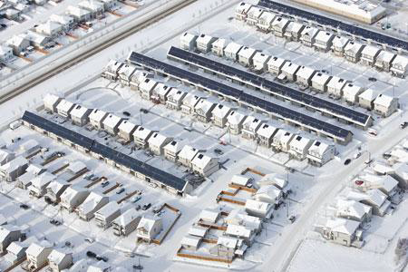
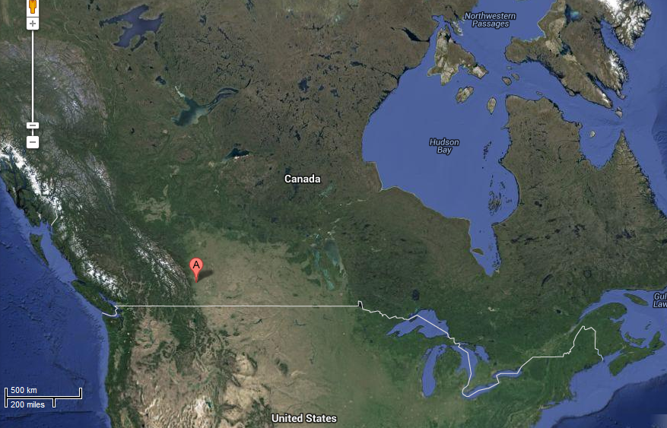
Solar thermal technologies
District heating network
Drake Landing Solar Community (Canada)
Source: http://www.dlsc.ca/
Source: http://www.maps.google.ca/

Slide 17
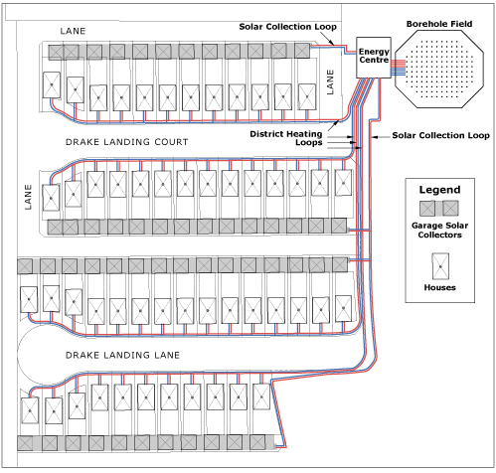
Solar thermal technologies
District heating network
Drake Landing Solar Community (Canada)
Build in 2007
Supply 52 house
2 300 m² of solar collector
Centralized production
Two storage systems
Short term, water240 m³
Long term, borehole 37m
The solar energy system is currently surpassing its 7 year performance goal of 90% solar fraction.

Slide 18
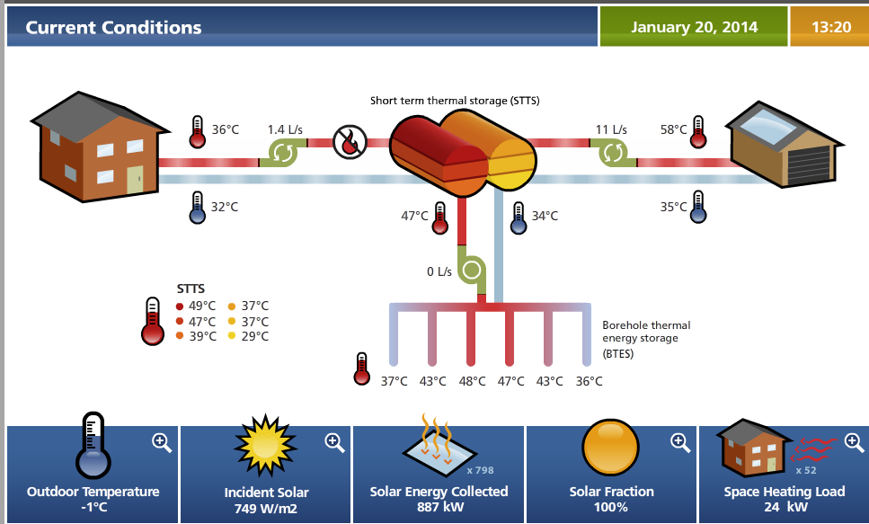
Solar thermal technologies
District heating network

Slide 19
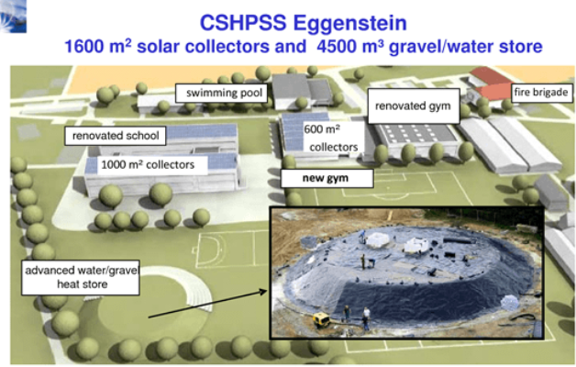
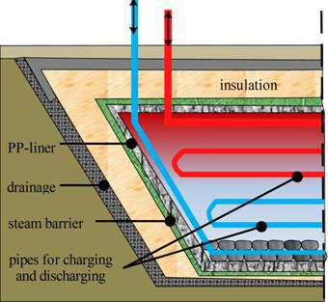
Solar thermal technologies
District heating with seasonnal heat storage
GWTES:

Slide 20
Solar thermal technologies
District heating with seasonnal heat storage

Slide 21
Solar thermal technologies
District heating with seasonnal heat storage

Slide 22
Solar thermal technologies
District heating with seasonnal heat storage
Vojens District Heating:
World records:
Solar 71,000 m2 (largest, so far, Chile 39,000 m2, 2 DK plants 33,000 / 36,000 m2, Riyadh 35,000 m2)
Pit heat storage, 205,000 m3. (largest, so far, Marstal, 75,000 m3)

Slide 23
Solar thermal technologies
District heating with seasonnal heat storage
Vojens District Heating:

Slide 24
Solar thermal technologies
District heating with seasonnal heat storage
Vojens District Heating:

Slide 25
Solar thermal technologies
District heating with seasonnal heat storage
Vojens District Heating:

Slide 26
Solar thermal technologies
District heating with seasonnal heat storage
Vojens District Heating:

Slide 27
Solar thermal technologies
District heating with seasonnal heat storage
Vojens District Heating:

Slide 28
Solar thermal technologies
District heating with seasonnal heat storage
Vojens District Heating:

Slide 29
Solar thermal technologies
District heating with seasonnal heat storage
Vojens District Heating:

Slide 30
Solar thermal technologies

Slide 31
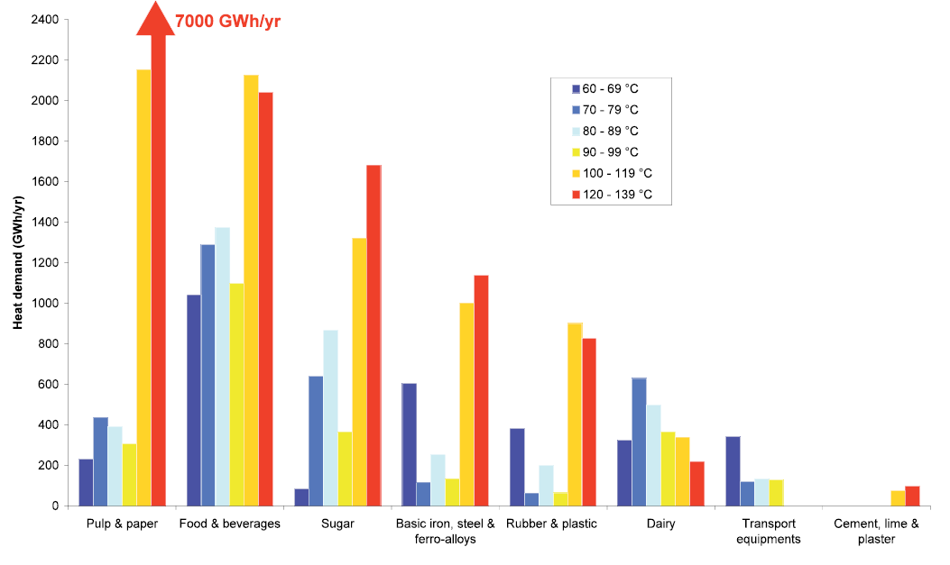
Solar thermal technologies
Industrial processes

Slide 32
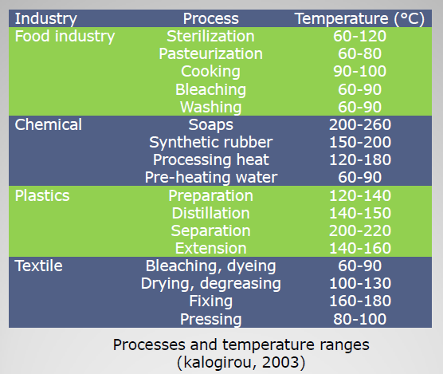
Solar thermal technologies
Solar thermal energy potential is huge in the following process !
www.ansole.org/download/webinar/solar process heat.pdf

Slide 33
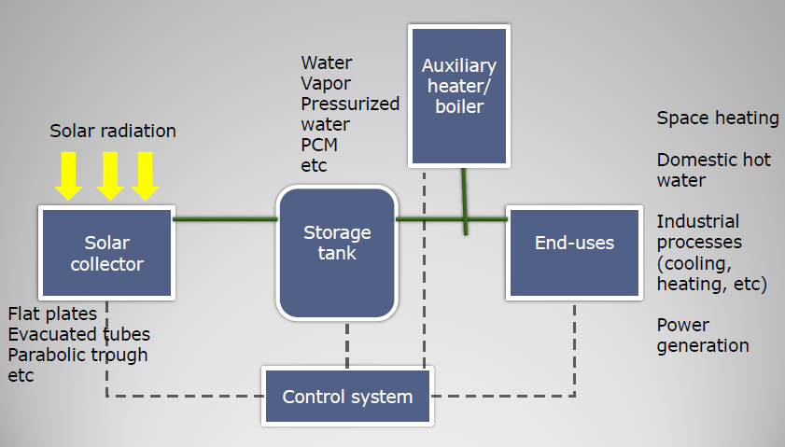
Solar thermal technologies
Components are similar to SDHW system (just the size differs)

Slide 34
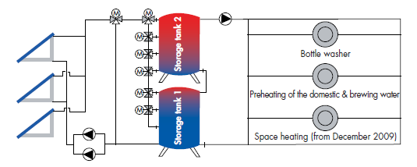
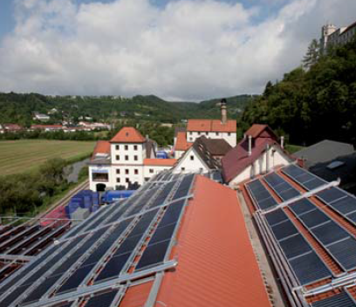
Solar thermal technologies
Industrial processes
Case study: Hofmühl brewery, Eichstätt Allemagne
835 m² Solar collector,
Two 55 m³ storage tank

Slide 35
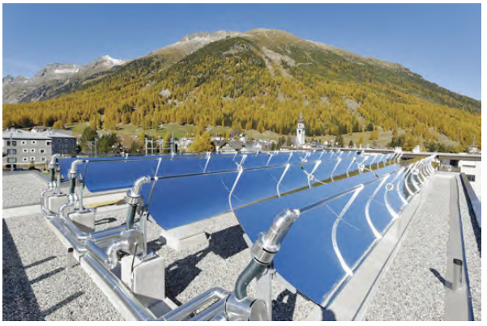
Solar thermal technologies
Industrial processes
Case study: Milk factory in Zurich
- 115 m² PT
- Thermal oil (200°C) to preheat steam

Slide 36
Solar thermal technologies
NewHeat
4200 m²
3,4 MW

Slide 37

Solar thermal technologies
Industrial processes
More info
http://task49.iea-shc.org/

Slide 38
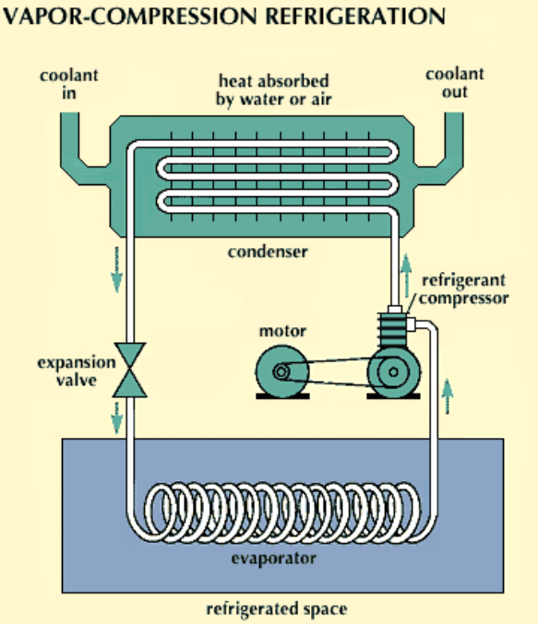
Solar thermal technologies
Solar cooling
P
Q_{c}
Condenser
Compressor
W_{c}
Evaporator
Q_{e}
T

Slide 39
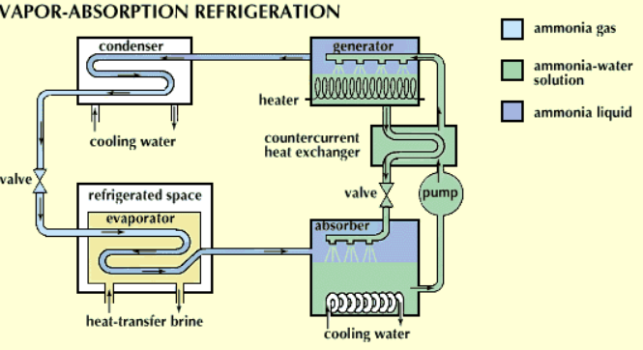
Solar thermal technologies
Solar cooling
P
Cooling tower
Solar energy
Q_{c}
Q_{g}
Condenser
Vapor
Generator
H₂O + Ammonia
Pump
W_{p}
Vapor
Evaporator
Absorber
Q_{e}
Q_{a}
Cooling tower
Ammonia Liquid
Solution ammonia
Ammonia vapor
T

Slide 40
Solar thermal technologies
Solar cooling
P
Cooling tower
Solar energy
Compression
COP between 3 and 5
Absorption
COP between 0,5 and 1,2
Q_{c}
Q_{g}
Condenser
Vapor
Generator
H₂O + Ammonia
Pump
W_{p}
Vapor
Evaporator
Absorber
Q_{e}
Q_{a}
Cooling tower
T

Slide 41
Solar thermal technologies
Solar cooling: Helioclim
Reversible solar air conditioning system
Parabolic solar Collector
Absorption Machine
4°C, -18°C and -60°C
DHW
Air conditioning
Innovative
Storage…
Absorbeur
Backup
Distribution

Slide 42
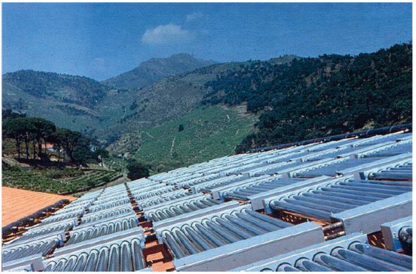
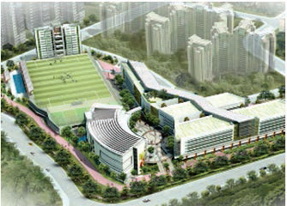
Solar thermal technologies
Solar cooling
Cave de Banyuls (France), 1989
130 m² solar collector,
52 kW
UW college (Singapore), 2012
3 900 m² solar collector,
1575 kW

Slide 43
Solar thermal technologies
2) Thermodynamic solar system
Conclusions and prospects

Slide 44
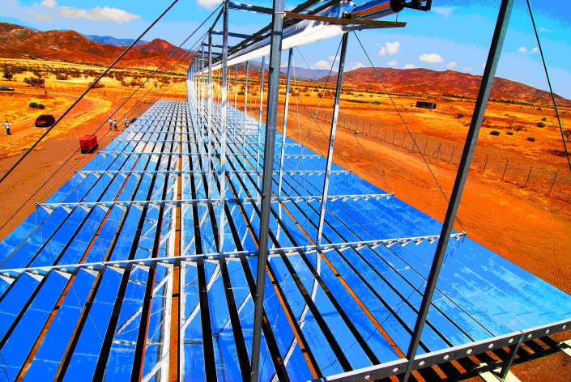
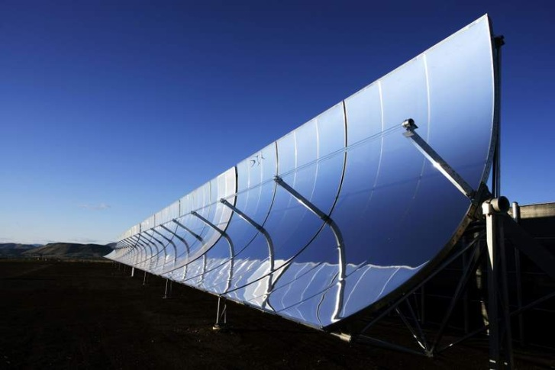
Thermodynamic solar system
Sun radiation>heat->power
Why to concentrate?

Slide 45
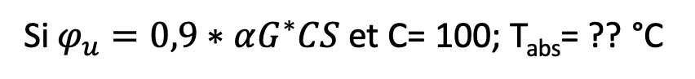
Thermodynamic solar system
Why concentrates the solar radiation ?
Very simplified case: S=1 m² and h= 10 W.m-².K⁻¹
$$αG^{∗}CS=εσS\left(T_{abs}^{4}−T_{sky}^{4}\right)+hS(Tabs−Tamb)$$
Solar radiation 1000 W.m⁻¹ and T_{amb}= 20°C
C = 1
T_{abs}= ?? °C
C = 100
T_{abs}= ??°C
If a part of heat is use for power cycle
$$αG^{∗}CS=εσS\left(T_{abs}^{4}−T_{sky}^{4}\right)+hS\left(Tabs−Tamb\right)+φ_{u}$$
Si $φ_{u}=0,9∗αG^{∗}CS$ et C= 100; T_{abs}= ?? °C

Slide 46
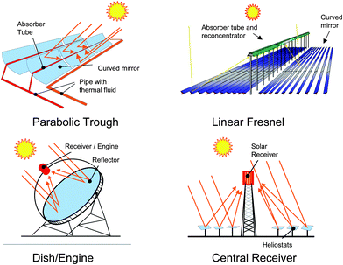
Thermodynamic solar system
Why concentrates the solar radiation ?
Moving absorber
Fixed absorber
Focus on a line
Focus on a point

Slide 47
Thermodynamic solar system
Impact of optical properties

Slide 48
Thermodynamic solar system
Impact of optical properties

Slide 49
Thermodynamic solar system
Impact of optical properties

Slide 50
Thermodynamic solar system
Impact of optical properties

Slide 51
Thermodynamic solar system
Impact of optical properties

Slide 52
Thermodynamic solar system
Impact of optical properties

Slide 53
Thermodynamic solar system
Mechanical and thermal materials properties

Slide 54
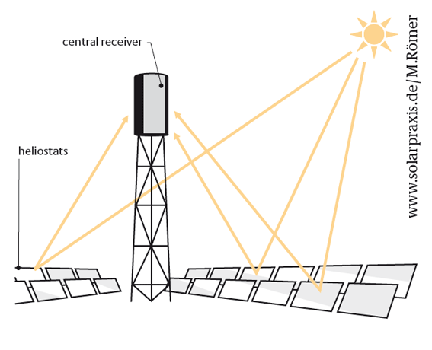
Thermodynamic solar system
Central receiver (solar tower)
Plane or slightly concave mirrors moving on two axes (azimuth and elevation)
Radiation concentrated at the top of the tower on the receiver
Concentration factor of approximately 1000
At the receiver the heat (up to 1000°C) is transfer to the HTF
DSG
Molten salt (HiTEC Solar salt)

Slide 55
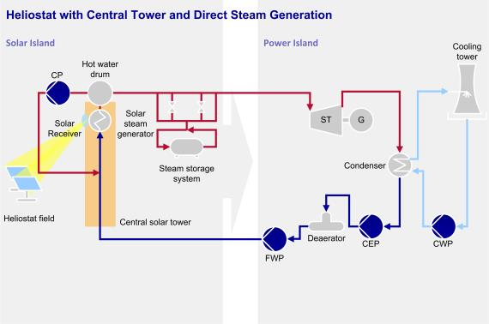
Thermodynamic solar system
Central receiver and DSG

Slide 56
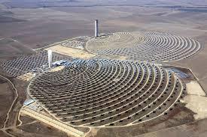
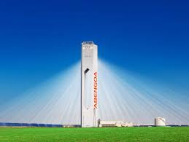
Thermodynamic solar system
Centrale receiver and DSG
PS 20 (Sevilla-Spain) – 2009
1 255 Heliostats (120 m²)
Tower 165 m heigh
Storage 1h
Rankine Cycle 20 MWe

Slide 57
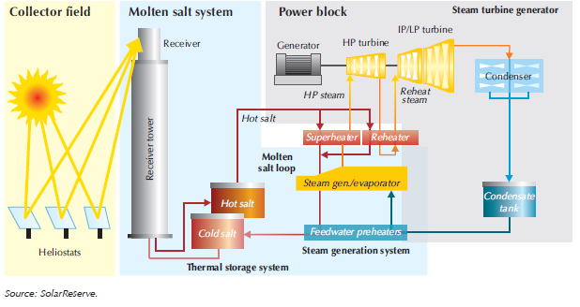
Thermodynamic solar system
Central receiver and molten salt

Slide 58
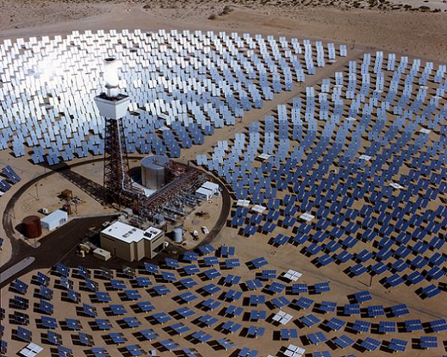
Thermodynamic solar system
Central receiver and molten salt
Solar Two (1995)
1 818 Heliostats (39 m²) + 108 (95 m²)
Tower 90 m height and 6 m diameter
Receiver 800 suns: 43 MWth
Storage 2*1 400 tons of nitrates
Vaport production 35 MWth, 100 bars and 538 °C
Rankine cycle 10 Mwe
Cost = 46 M€ then 4,6/MWe

Slide 59
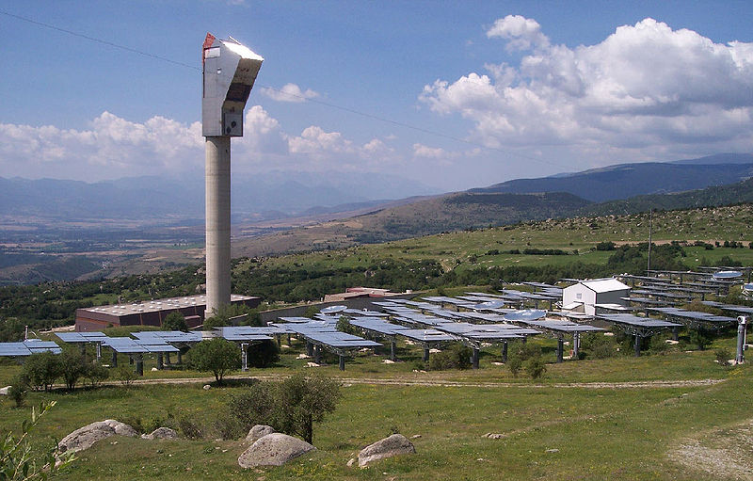
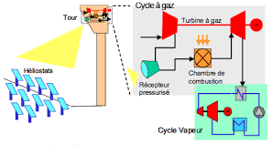
Thermodynamic solar system
Central receiver summary
=> In 2015, 562 MW installed, hence 14%
R&D project in France
PEGASE (CNRS-PROMES)
-Pressurized air receiver combined to a gaz turbine (2MWe)

Slide 60

Thermodynamic solar system
Dish Stirling (Parabolic reflector-moving receiver)
Concentration factor from 1000 to 3000 suns !
Parabolic reflector up to 400 m²
Two axes tracking
Stirling engine to generate power (250-700°C)
On the edge technology

Slide 61
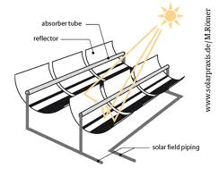
Thermodynamic solar system
Parabolic Through, PT :
Produce temperatures of about 450°C
Parabolic curved mirror north-south oriented
One axis tracking
Absorber tube runs along the focal line
HTF= usually thermal oil but sometimes molten salt or DSG
Concentration factor: 8-80

Slide 62
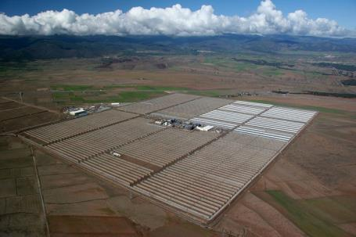
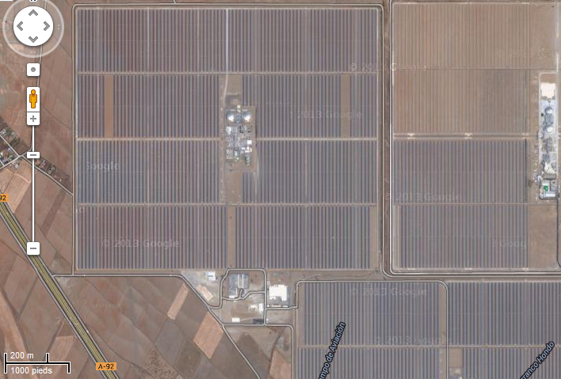

Thermodynamic solar system
Parabolic Through, PT :
Andasol 1 (2008) :
50 MWe, 45 000 houses
7,5 h two tank storage
300 M€ hence 6M€/MWe
Electricity cost price 27 c€/kWh

Slide 63

Thermodynamic solar system
Parabolic Through, PT :
Andasol 1 (2008) :
Solar field Tin=293°C; Tout=393°C
Solar field efficiency max. 70%, avg. 50%
Rankine cycle100 bar
Turbine max.40% , avg. 30%
Total max.28%, avg. 15%

Slide 64


Thermodynamic solar system
Parabolic Through, PT :
SEGS, Mojave, California
World largest 354 MW
HTF, synthetic oil 400°C
Rankine cycle
Combined with Gaz
NOOR 1 => 170 MW
2+3 => nearly 600 MW

Slide 65




Thermodynamic solar system
Parabolic Through, PT :
SEGS, California
In total, in 2015, 3 452 MW installed, therefore 85 % of the installed capacity (500 MW in construction in Morocco)

Slide 66

Thermodynamic solar system
Compact Linear Fresnel Reflector, CLFR :
Up to 550°C
Concentration factor 10-200
Fixe absorber tube
Only slightly curved, flat mirrors

Slide 67

Thermodynamic solar system
Centrale de Puerto Errado 2 – Spain
28 lines 940 m long
Temperature outlet of the solar field 270°C
Power cycle pressure 55 bar
Production 150 MWth and 30 Mwe
Storage ½ h

Slide 68
Thermodynamic solar system
Compact Linear Fresnel Reflector, CLFR :
Advantages :
Absorber are fixed (less moving part-link at the end of the line) ,
The movements of mirrors, their designs and size and this their manufacturing are simplified. The wind resistance is greater.
Increases the temperature level (goal => DSG)
Disadvantages:
Lower maturity (but many R & D projects in progress).

Slide 69

Thermodynamic solar system
Compact Linear Fresnel Reflector, CLFR :
- In total, 45 MW hence 1%
- Numerous R & D projects, even in France
Llo, 64, CNIM
9 Mwe, 3 hours storage
Construction has began in 2016

Slide 70

Thermodynamic solar system
Opération, construction or in development in 2015

Slide 71

Thermodynamic solar system

Slide 72

Thermodynamic solar system

Slide 73


Thermodynamic solar system
Conclusion and prospects

Slide 74





Thermodynamic solar system
Power plant
500
600
From International Energy Agency. Technology Roadmap. Solar heating and cooling 2012

Slide 75
Reference
Duffie, J.A., Beckman, W.A., 1991. Solar Engineering of Thermal Processes. Wiley.
Peuser, F.A., Remmers, K-H., Schnauss, M., « Installations Solaires thermiques, Conception et mise en oeuvre », Ed. Systèmes Solaires, 206, 403 pages
Weis W., Mauthner F., Solar Heat Worldwide, SHC programme de l’IEA, Edition 2015. http://www.iea-shc.org/solar-heat-worldwide
International Energy Agency. Solar thermal electricity 2015 https://www.iea.org/publications/freepublications/publication/TechnologyRoadmapSolarThermalElectricity_2014edition.pdf
International Energy Agency. Technology Roadmap. Solar heating and cooling 2012 http://www.iea.org/publications/freepublications/

